Slide 1

제20강 레이아웃설계(3)
다양한 레이아웃에서 버튼 뷰와 테스트 뷰를 활용한 실습
학습 목표
레이아웃의 기본 속성을 이해한다.
다양한 종류의 레이아웃의 특성을 익힌다.
뷰와 연계된 안드로이드 레이아웃 설계를 이해한다.

Slide 2
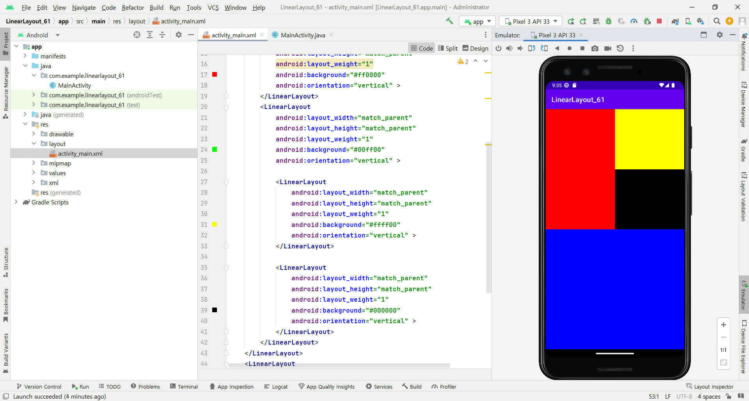
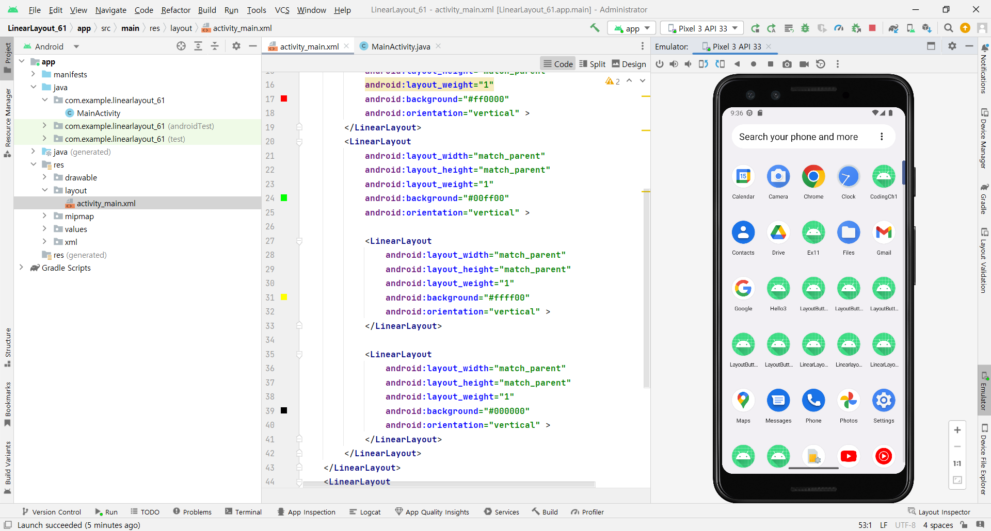
리니어Layout설계실습-61
중복리니어 weight 형태로 배치

Slide 3
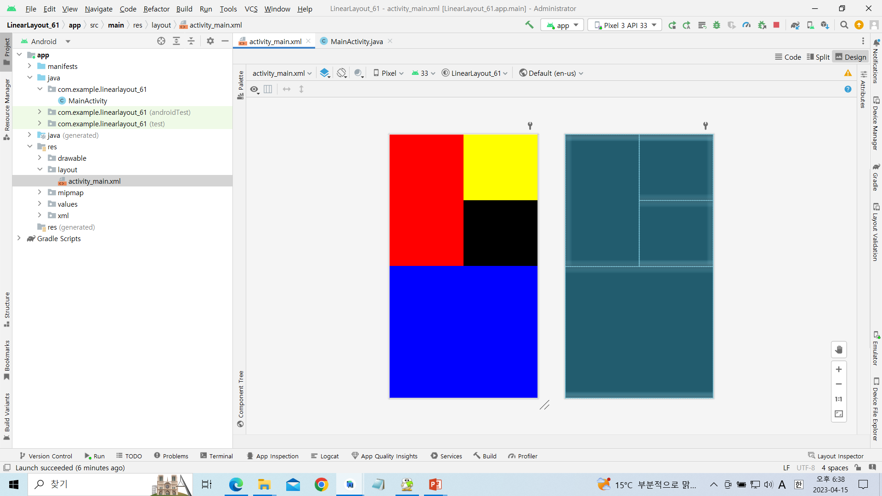
[activity_main.xml]

Slide 4
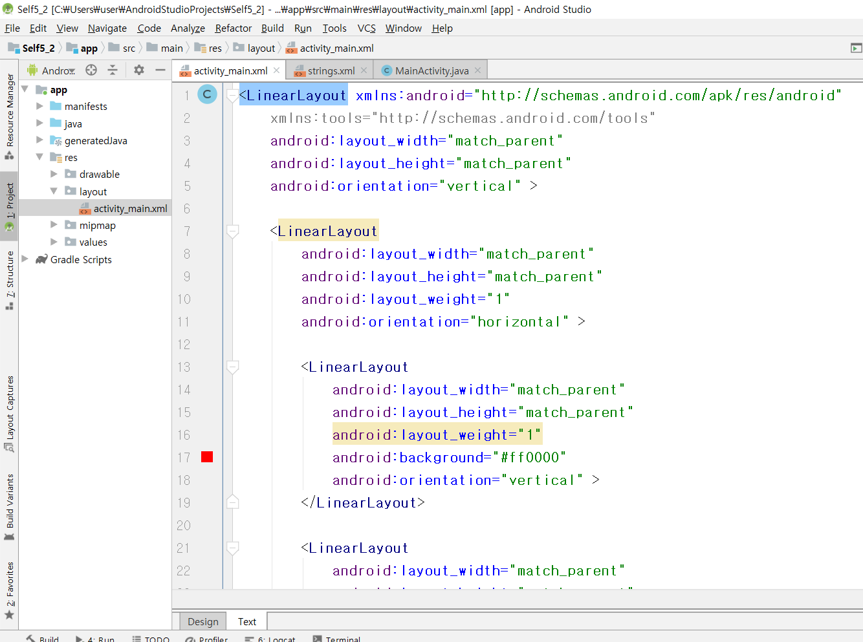

Slide 5
<LinearLayout xmlns:android="http://schemas.android.com/apk/res/android"
xmlns:tools="http://schemas.android.com/tools"
android:layout_width="match_parent"
android:layout_height="match_parent"
android:orientation="vertical" >
<LinearLayout
android:layout_width="match_parent"
android:layout_height="match_parent"
android:layout_weight="1"
android:orientation="horizontal" >
<LinearLayout
android:layout_width="match_parent"
android:layout_height="match_parent"
android:layout_weight="1"
android:background="#ff0000"
android:orientation="vertical" >
</LinearLayout>

Slide 6
<LinearLayout
android:layout_width="match_parent"
android:layout_height="match_parent"
android:layout_weight="1"
android:background="#00ff00"
android:orientation="vertical" >
<LinearLayout
android:layout_width="match_parent"
android:layout_height="match_parent"
android:layout_weight="1"
android:background="#ffff00"
android:orientation="vertical" >
</LinearLayout>
<LinearLayout
android:layout_width="match_parent"
android:layout_height="match_parent"
android:layout_weight="1"
android:background="#000000"
android:orientation="vertical" >
</LinearLayout>
</LinearLayout>
</LinearLayout>

Slide 7
<LinearLayout
android:layout_width="match_parent"
android:layout_height="match_parent"
android:layout_weight="1"
android:background="#0000ff"
android:orientation="vertical" >
</LinearLayout>
</LinearLayout>

Slide 8
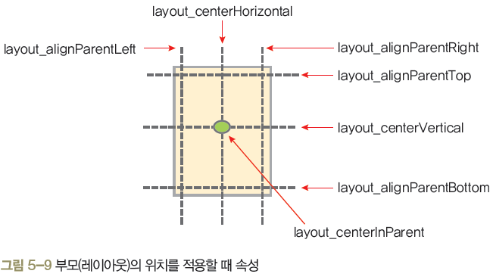
Relative 레이아웃
렐러티브레이아웃(상대 레이아웃)
렐러티브레이아웃은 레이아웃 내부에 포함된 위젯을 상대적인 위치로 배치
렐러티브레이아웃의 상하좌우에 배치

Slide 9
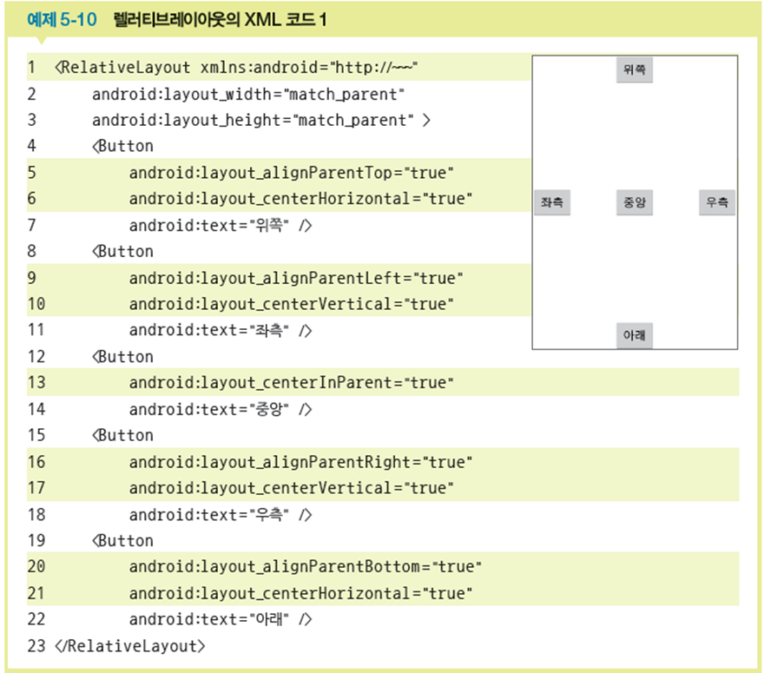
렐러티브레이아웃 예제

Slide 10
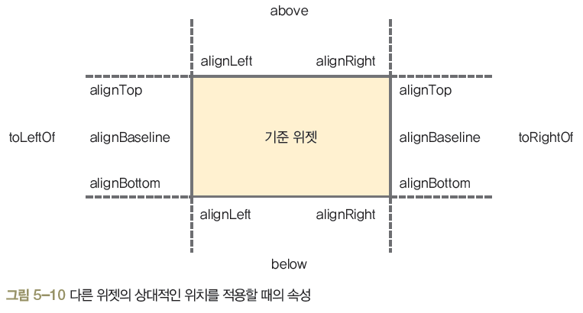
다른 위젯의 상대 위치에 배치
각 속성의 값은 다른 위젯의 id를 지정하면 됨
“@+id/기준 위젯의 아이디”와 같은 형식으로 사용
간략하게 표현하기 위해
속성 이름의 layout_은 생략

Slide 11
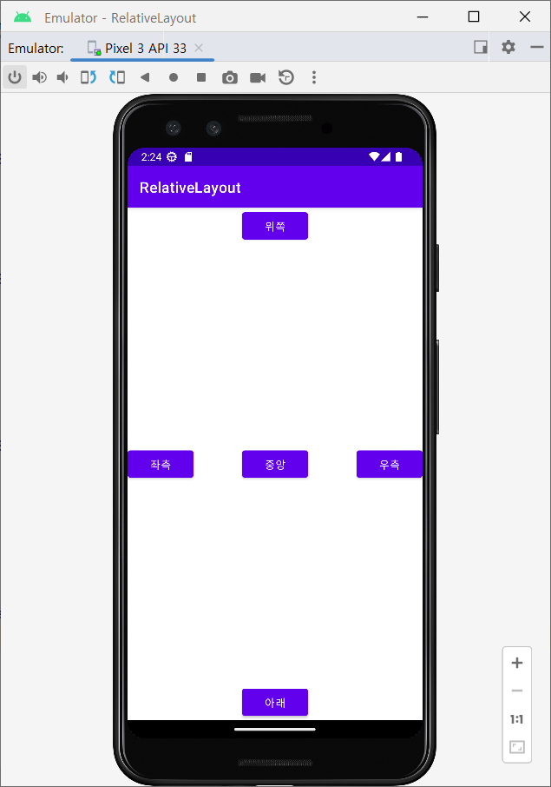
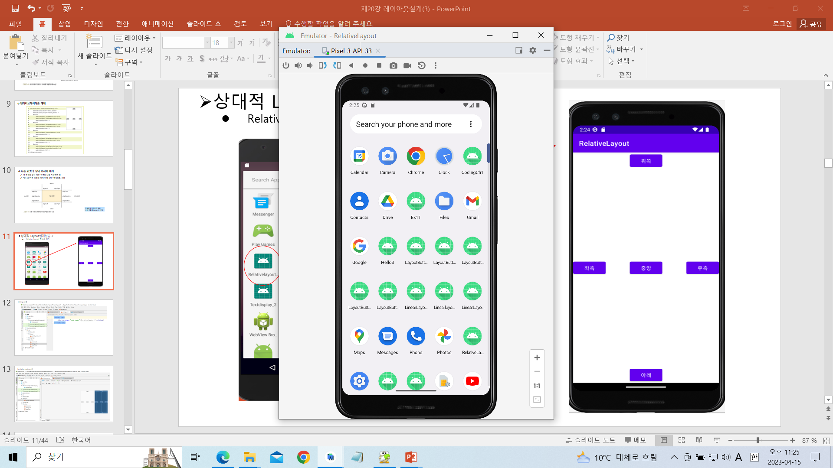
상대적 Layout설계실습-7
Relative Layout 형태로 배치

Slide 12
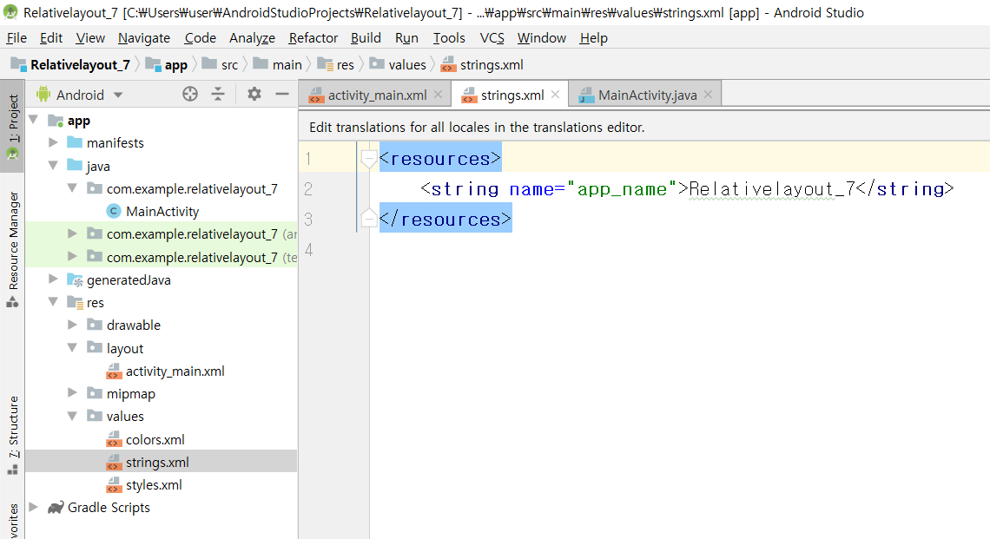
[string.xml]

Slide 13
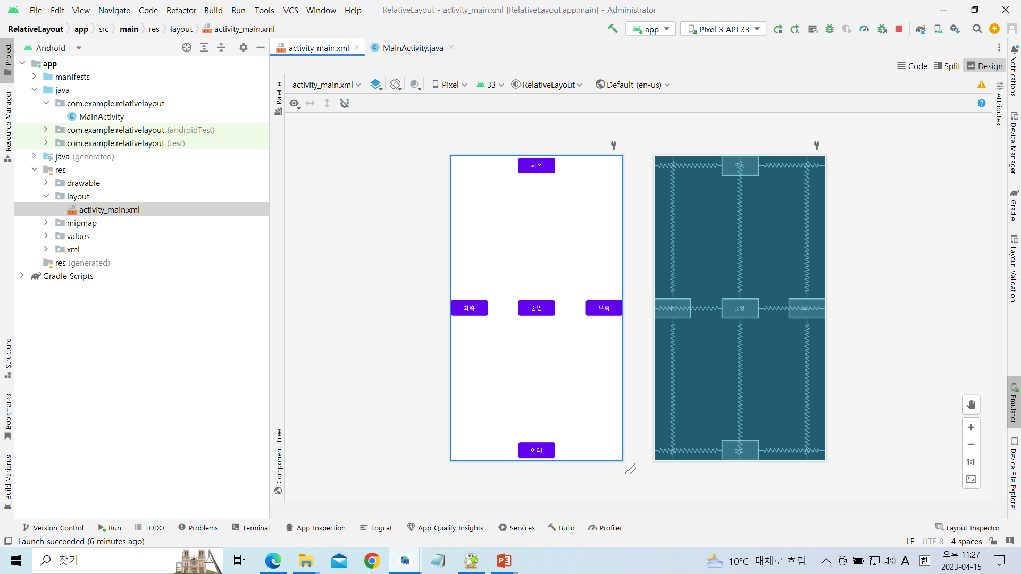
[activity_main.xml]

Slide 14
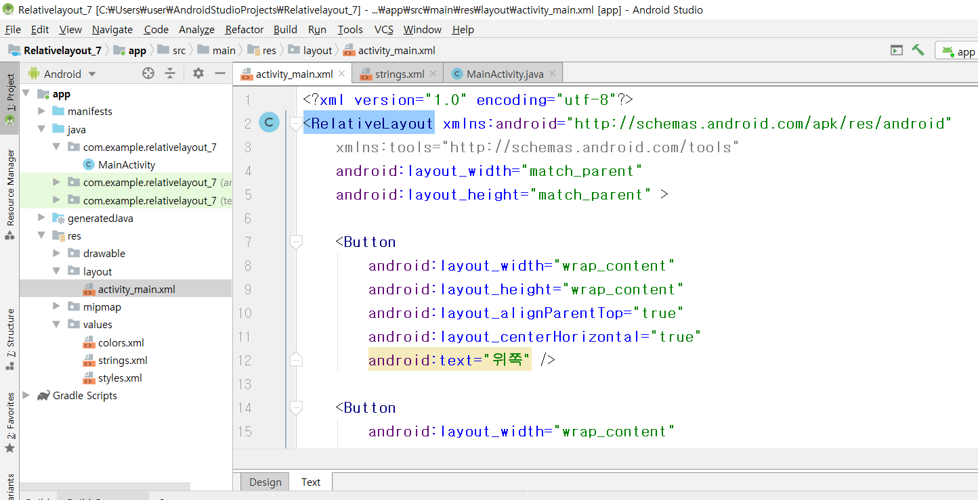

Slide 15
<?xml version="1.0" encoding="utf-8"?>
<RelativeLayout xmlns:android="http://schemas.android.com/apk/res/android"
xmlns:tools="http://schemas.android.com/tools"
android:layout_width="match_parent"
android:layout_height="match_parent" >
<Button
android:layout_width="wrap_content"
android:layout_height="wrap_content"
android:layout_alignParentTop="true"
android:layout_centerHorizontal="true"
android:text="위쪽" />
<Button
android:layout_width="wrap_content"
android:layout_height="wrap_content"
android:layout_alignParentLeft="true"
android:layout_centerVertical="true"
android:text="좌측" />
<Button
android:layout_width="wrap_content"
android:layout_height="wrap_content"
android:layout_centerInParent="true"
android:text="중앙" />

Slide 16
<Button
android:layout_width="wrap_content"
android:layout_height="wrap_content"
android:layout_alignParentRight="true"
android:layout_centerVertical="true"
android:text="우측" />
<Button
android:layout_width="wrap_content"
android:layout_height="wrap_content"
android:layout_alignParentBottom="true"
android:layout_centerHorizontal="true"
android:text="아래" />
</RelativeLayout>

Slide 17
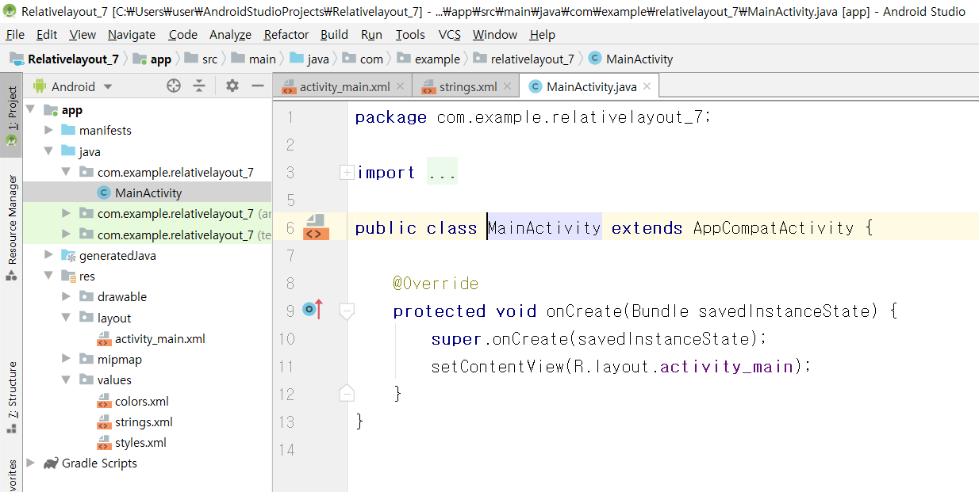
[MainActivity.java]

Slide 18
package com.example.relativelayout_7;
import android.support.v7.app.AppCompatActivity;
import android.os.Bundle;
public class MainActivity extends AppCompatActivity {
@Override
protected void onCreate(Bundle savedInstanceState) {
super.onCreate(savedInstanceState);
setContentView(R.layout.activity_main);
}
}

Slide 19
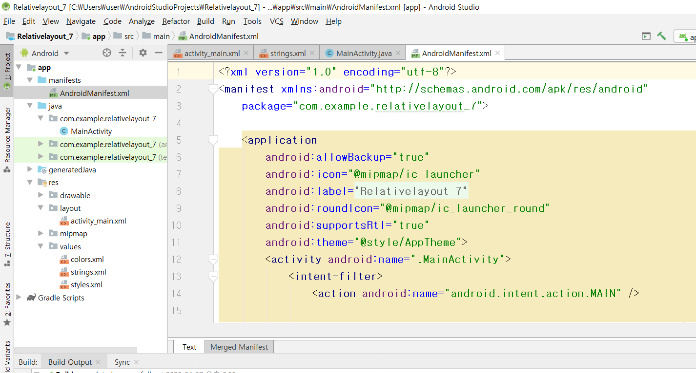
[AndroidManifest.xml]

Slide 20
<?xml version="1.0" encoding="utf-8"?>
<manifest xmlns:android="http://schemas.android.com/apk/res/android"
package="com.example.relativelayout_7">
<application
android:allowBackup="true"
android:icon="@mipmap/ic_launcher"
android:label="@string/app_name"
android:roundIcon="@mipmap/ic_launcher_round"
android:supportsRtl="true"
android:theme="@style/AppTheme">
<activity android:name=".MainActivity">
<intent-filter>
<action android:name="android.intent.action.MAIN" />
<category android:name="android.intent.category.LAUNCHER" />
</intent-filter>
</activity>
</application>
</manifest>

Slide 21
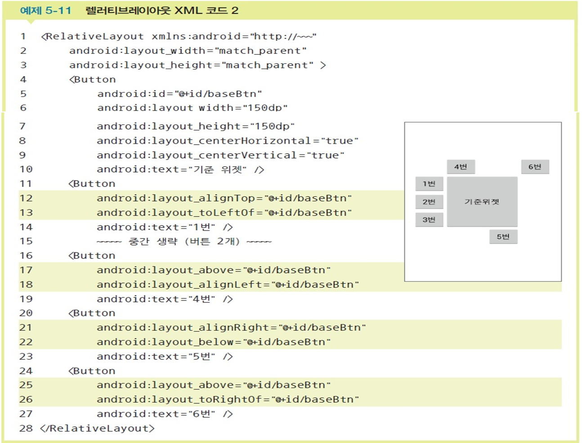
렐러티브레이아웃 안에서 다른 위젯의 특정한 곳 배치 예제

Slide 22
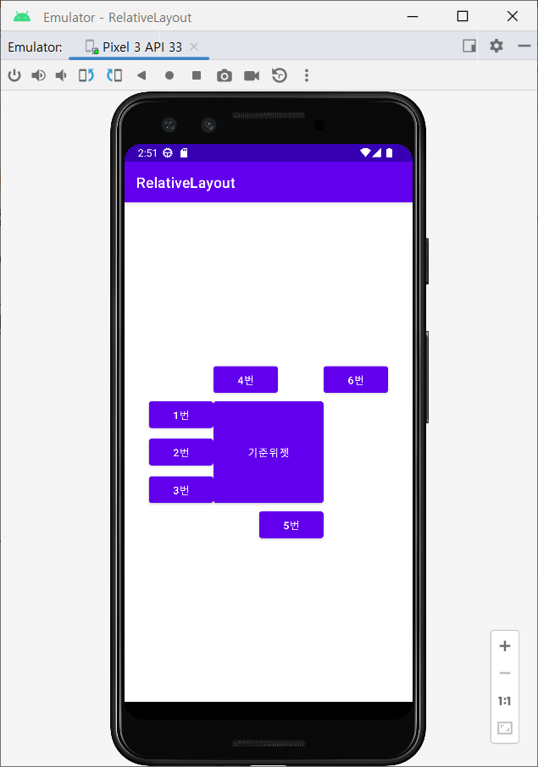
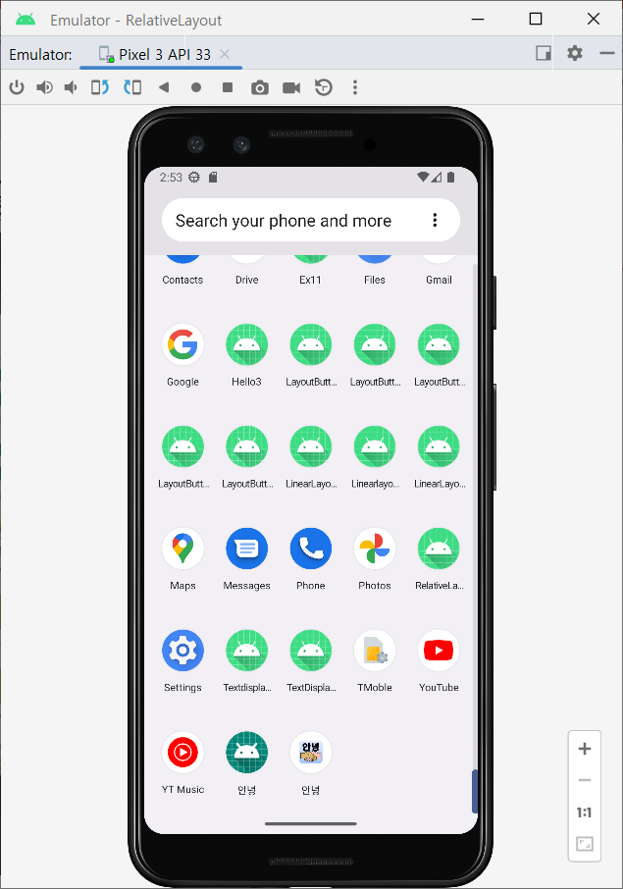
상대적 Layout설계실습-8
다른 위젯의 상대위치에 배치

Slide 23
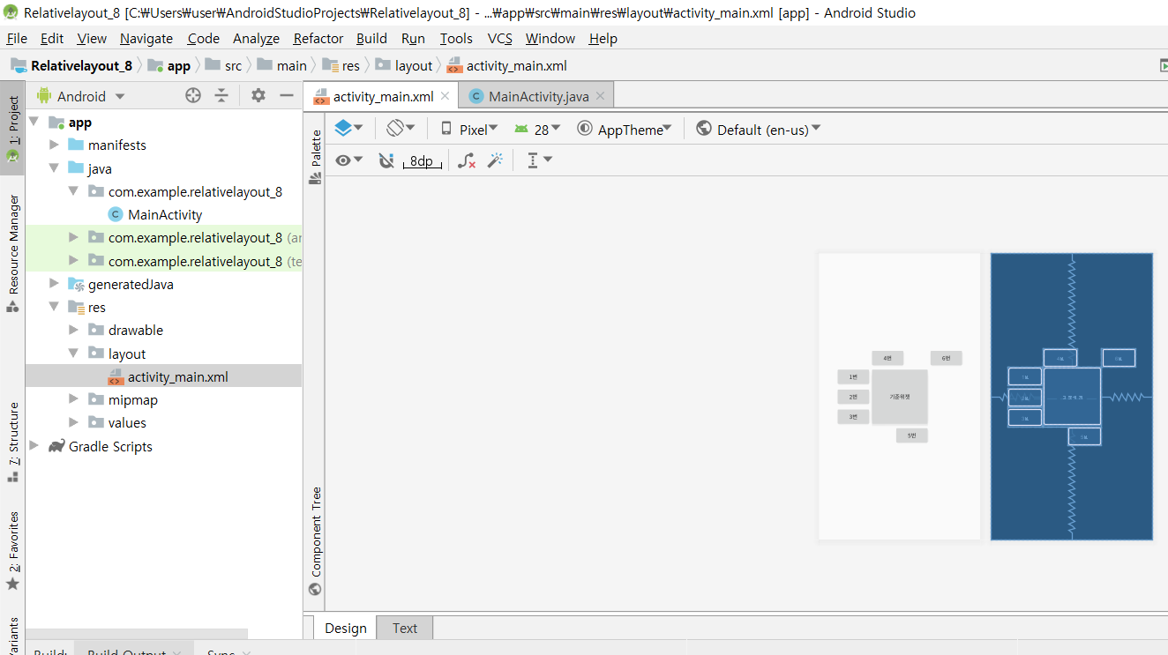
[activity_main.xml]

Slide 24
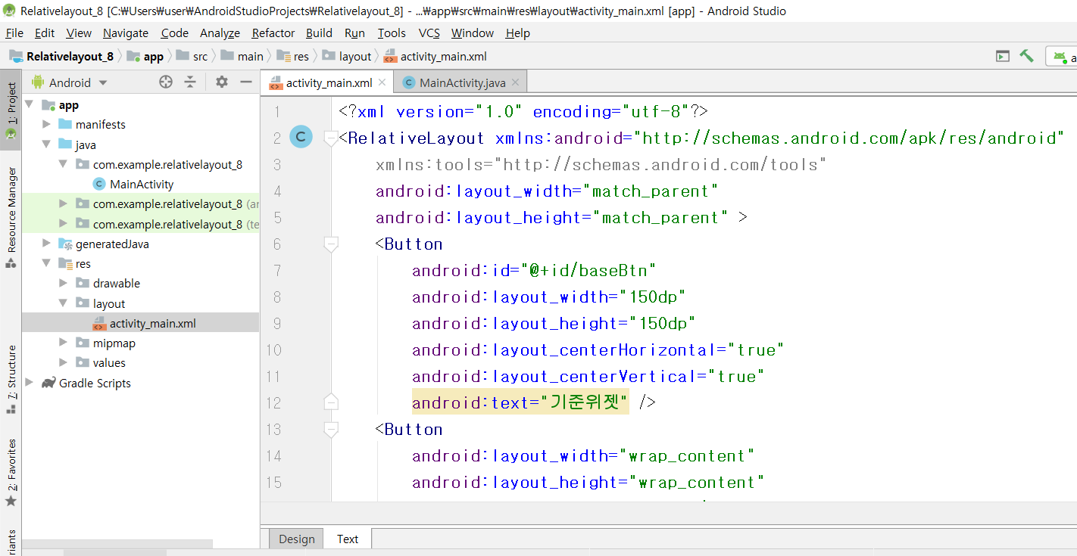

Slide 25
<?xml version="1.0" encoding="utf-8"?>
<RelativeLayout xmlns:android="http://schemas.android.com/apk/res/android"
xmlns:tools="http://schemas.android.com/tools"
android:layout_width="match_parent"
android:layout_height="match_parent" >
<Button
android:id="@+id/baseBtn"
android:layout_width="150dp"
android:layout_height="150dp"
android:layout_centerHorizontal="true"
android:layout_centerVertical="true"
android:text="기준위젯" />
<Button
android:layout_width="wrap_content"
android:layout_height="wrap_content"
android:layout_alignTop="@+id/baseBtn"
android:layout_toLeftOf="@+id/baseBtn"
android:text="1번" />

Slide 26
<Button
android:layout_width="wrap_content"
android:layout_height="wrap_content"
android:layout_alignBaseline="@+id/baseBtn"
android:layout_toLeftOf="@+id/baseBtn"
android:text="2번" />
<Button
android:layout_width="wrap_content"
android:layout_height="wrap_content"
android:layout_alignBottom="@+id/baseBtn"
android:layout_toLeftOf="@+id/baseBtn"
android:text="3번" />
<Button
android:id="@+id/button2"
android:layout_width="wrap_content"
android:layout_height="wrap_content"
android:layout_above="@+id/baseBtn"
android:layout_alignLeft="@+id/baseBtn"
android:text="4번" />

Slide 27
<Button
android:layout_width="wrap_content"
android:layout_height="wrap_content"
android:layout_alignRight="@+id/baseBtn"
android:layout_below="@+id/baseBtn"
android:text="5번" />
<Button
android:layout_width="wrap_content"
android:layout_height="wrap_content"
android:layout_above="@+id/baseBtn"
android:layout_toRightOf="@+id/baseBtn"
android:text="6번" />
</RelativeLayout>

Slide 28
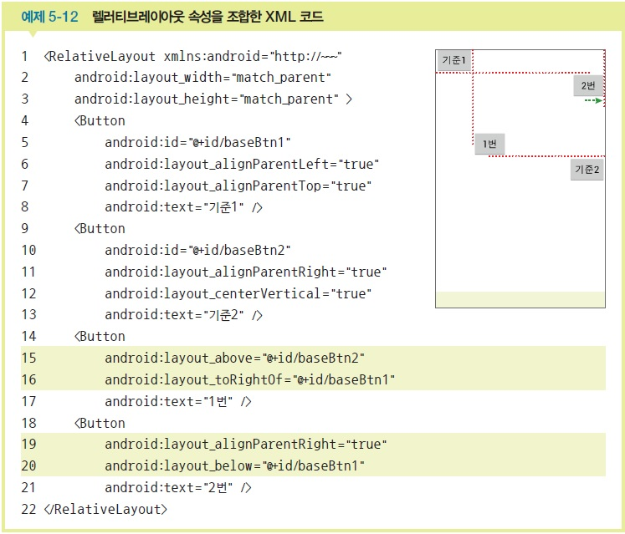
여러 위젯에서 상대 위치를 지정한 예제

Slide 29
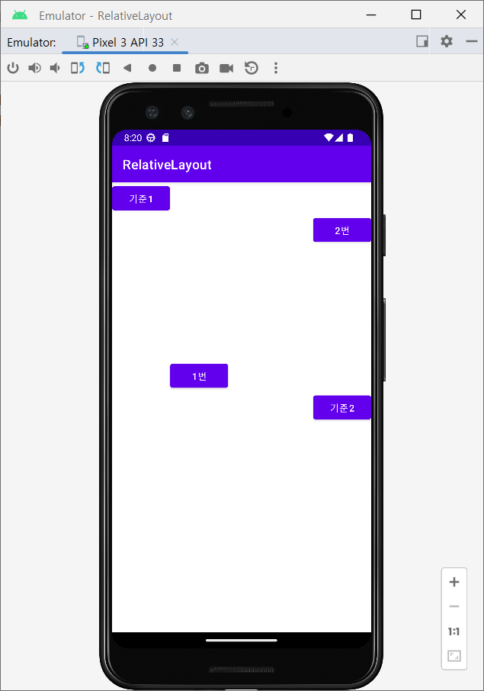

상대적 Layout설계실습-9
다른 위젯의 상대위치에 배치

Slide 30
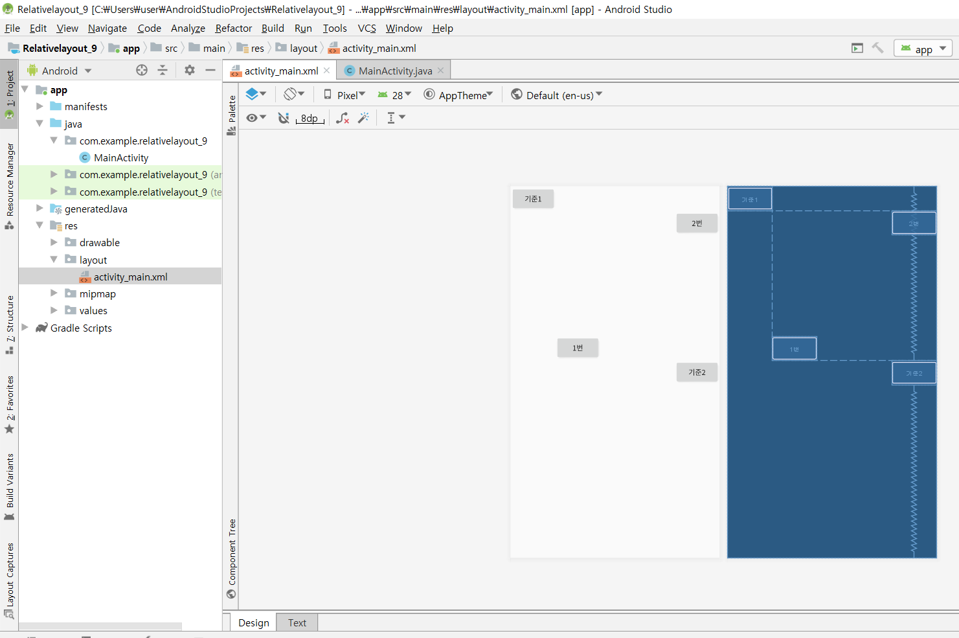
[activity_main.xml]

Slide 31
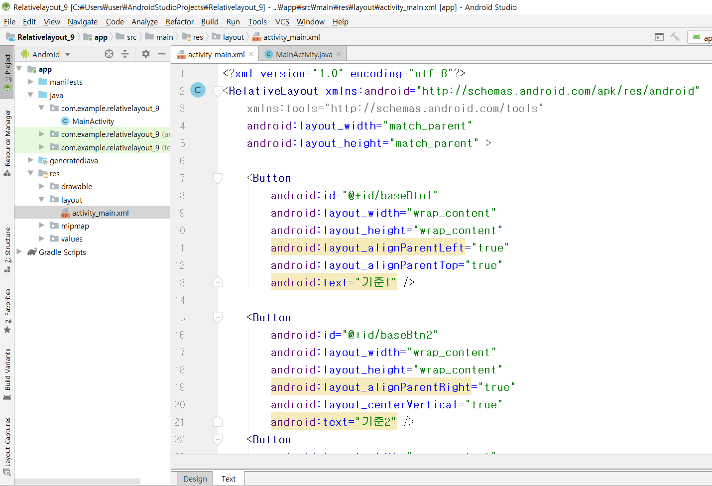

Slide 32
<?xml version="1.0" encoding="utf-8"?>
<RelativeLayout xmlns:android="http://schemas.android.com/apk/res/android"
xmlns:tools="http://schemas.android.com/tools"
android:layout_width="match_parent"
android:layout_height="match_parent" >
<Button
android:id="@+id/baseBtn1"
android:layout_width="wrap_content"
android:layout_height="wrap_content"
android:layout_alignParentLeft="true"
android:layout_alignParentTop="true"
android:text="기준1" />
<Button
android:id="@+id/baseBtn2"
android:layout_width="wrap_content"
android:layout_height="wrap_content"
android:layout_alignParentRight="true"
android:layout_centerVertical="true"
android:text="기준2" />

Slide 33
<Button
android:layout_width="wrap_content"
android:layout_height="wrap_content"
android:layout_above="@+id/baseBtn2"
android:layout_toRightOf="@+id/baseBtn1"
android:text="1번" />
<Button
android:layout_width="wrap_content"
android:layout_height="wrap_content"
android:layout_alignParentRight="true"
android:layout_below="@+id/baseBtn1"
android:text="2번" />
</RelativeLayout>

Slide 34
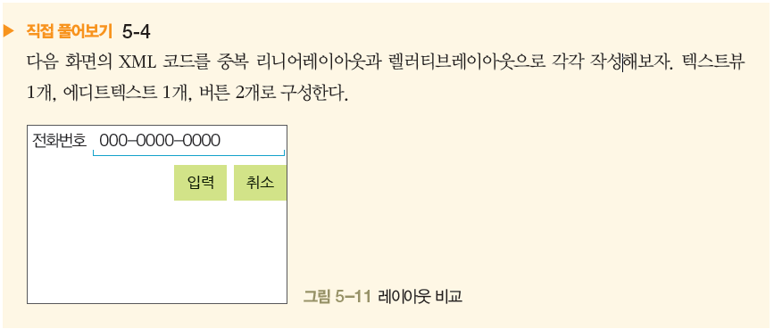

Slide 35
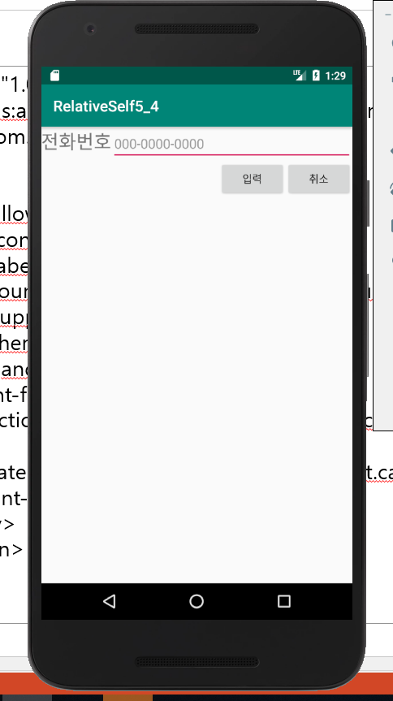
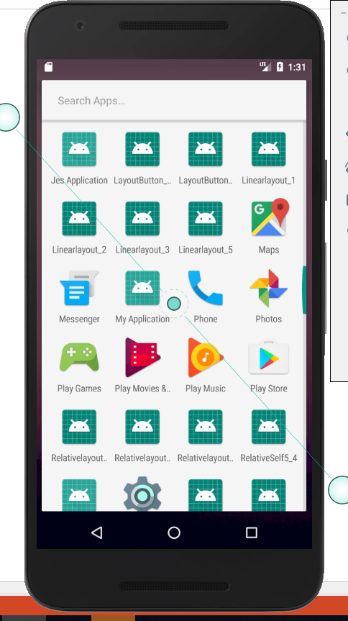

Slide 36
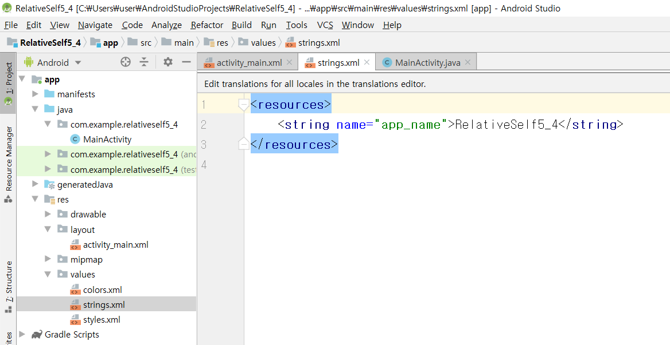
[string.xml]

Slide 37
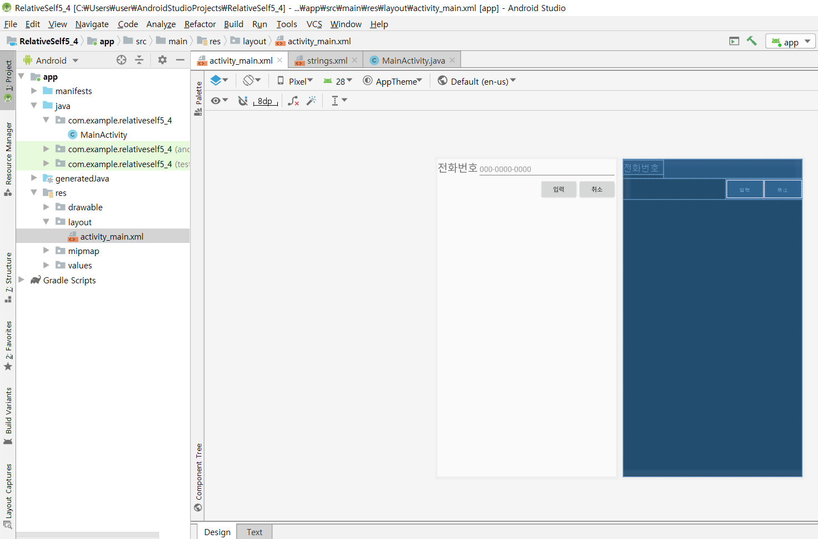
[activity_main.xml]

Slide 38
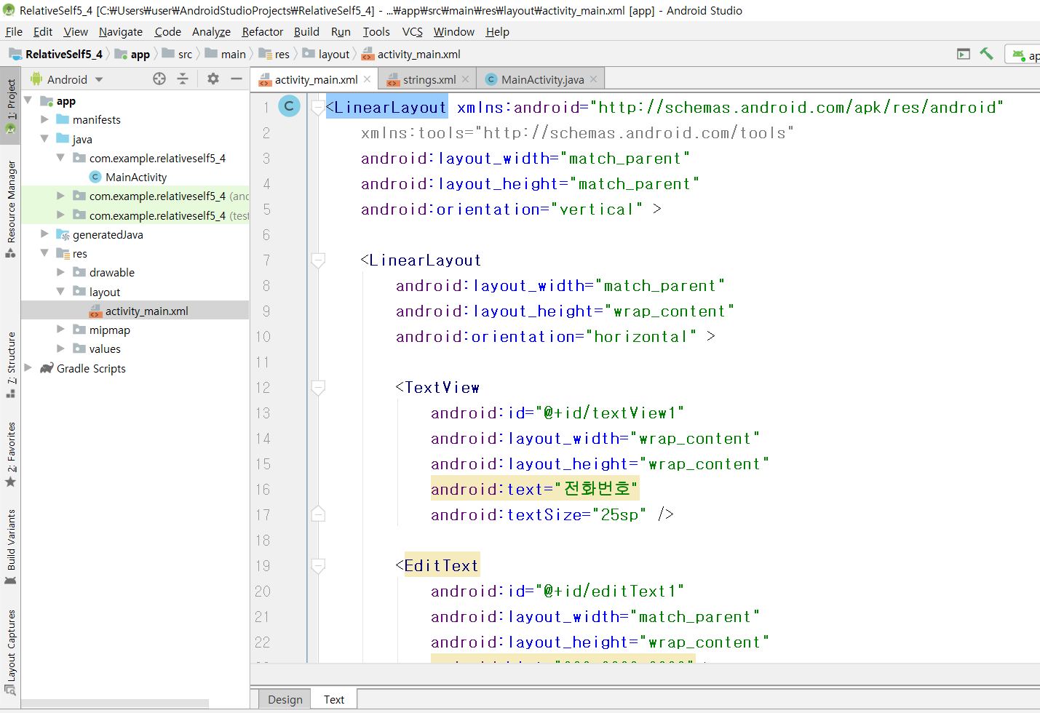

Slide 39
<LinearLayout xmlns:android="http://schemas.android.com/apk/res/android" xmlns:tools="http://schemas.android.com/tools" android:layout_width="match_parent" android:layout_height="match_parent" android:orientation="vertical" > <LinearLayout android:layout_width="match_parent" android:layout_height="wrap_content" android:orientation="horizontal" > <TextView android:id="@+id/textView1" android:layout_width="wrap_content" android:layout_height="wrap_content" android:text="전화번호" android:textSize="25sp" /> <EditText android:id="@+id/editText1" android:layout_width="match_parent" android:layout_height="wrap_content" android:hint="000-0000-0000" > </EditText> </LinearLayout>

Slide 40
<LinearLayout
android:layout_width="match_parent"
android:layout_height="wrap_content"
android:gravity="right"
android:orientation="horizontal" >
<Button
android:id="@+id/btnOK"
android:layout_width="wrap_content"
android:layout_height="wrap_content"
android:text="입력" />
<Button
android:id="@+id/btnCancel"
android:layout_width="wrap_content"
android:layout_height="wrap_content"
android:text="취소" />
</LinearLayout>
</LinearLayout>

Slide 41
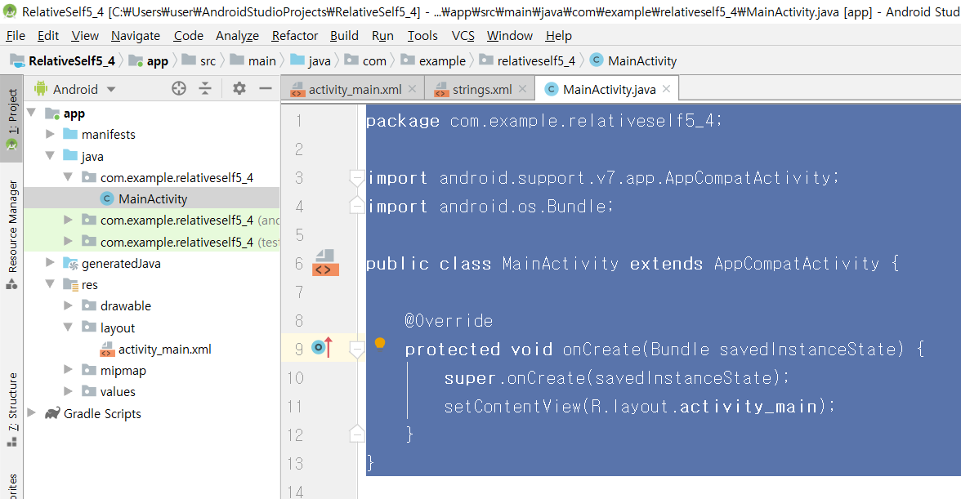
[MainActivity.java]

Slide 42
package com.example.relativeself5_4;
import android.support.v7.app.AppCompatActivity;
import android.os.Bundle;
public class MainActivity extends AppCompatActivity {
@Override
protected void onCreate(Bundle savedInstanceState) {
super.onCreate(savedInstanceState);
setContentView(R.layout.activity_main);
}
}

Slide 43
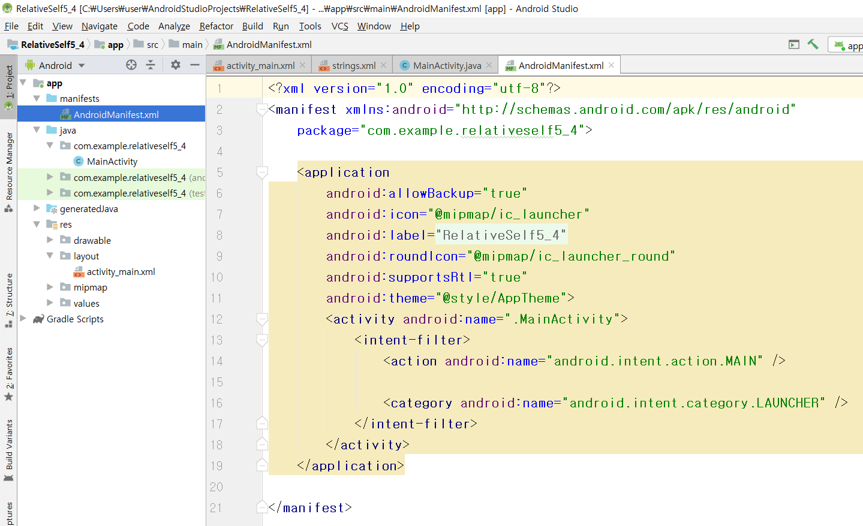
[AndroidManifest.xml]

Slide 44
<?xml version="1.0" encoding="utf-8"?>
<manifest xmlns:android="http://schemas.android.com/apk/res/android"
package="com.example.relativeself5_4">
<application
android:allowBackup="true"
android:icon="@mipmap/ic_launcher"
android:label="@string/app_name"
android:roundIcon="@mipmap/ic_launcher_round"
android:supportsRtl="true"
android:theme="@style/AppTheme">
<activity android:name=".MainActivity">
<intent-filter>
<action android:name="android.intent.action.MAIN" />
<category android:name="android.intent.category.LAUNCHER" />
</intent-filter>
</activity>
</application>
</manifest>

